Slide 1
Senior Seminar CMPS 490
By Luke Caraccioli and Mark Silvius

Slide 2
Server Set up
For the server we used an older computer with an AMD X2 dual core processor, 4 GB of RAM, and a 320 GB hard drive.
We acquired Microsoft SQL server 2008 R2 and SQL server 2012 via the Microsoft Academic Alliance for free.
We then installed the software on the server and set the LAN IP address to static.
Next, we set up the router to port forward Remote Desktop (RDP) and SQL server requests to the server.

Slide 3
.Net framework
.NET framework is a software framework developed by Microsoft and includes a large library and language interoperability across several different programming languages.
Code that is written in .NET executes in an environment known as CLR Common Language Runtime, which is a virtual machine that provides services such as security, memory management, and exception handling.
We chose this framework because it is the latest, most advanced language for developing applications and also it is very user friendly.
We are able to write queries in C#, HTML, JavaScript when needed, and use Telerik Tools all in the Microsoft Visual Studio environment.

Slide 4
AJAX, HTML5, CSS, Telerik
AJAX is an acronym for asynchronous JavaScript and XML. This is a group of interrelated web development techniques used to develop the client side to create applications for the web.
AJAX allows for the web application to send data to and receive data from the server without disturbing the front end display.
AJAX can be used in conjunction with HTML, CSS, and JavaScript making it very versatile.

Slide 5
Project Goals
Store Inventory
Track Inventory
Enter New products easily
Generate a barcode for each new entry
Generate useful reports
Export Reports to pdf

Slide 6
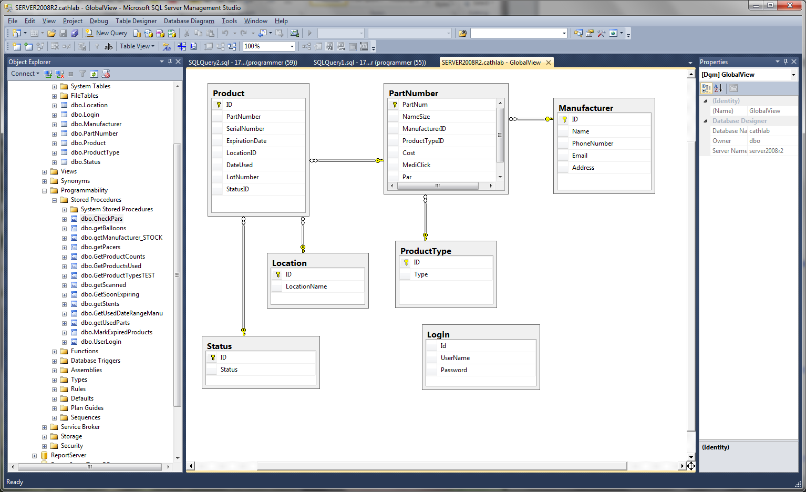
Database

Slide 7
Product Entity
 | ID | Part Number | Serial Number | Expiration Date | Location ID | Date Used | Lot Number | Status ID
Description | unique key | foreign key | part serial num | date product expires | product location | date product was used | Product Lot # | Status designator
Domain/Type | int | var/char | var/char | date/time | int | date/time | int | int
Value Range | 0-9 | any | any | any | 0-9 | any | 0-9 | 0-9
Default Value | auto assigned | none | none | none | none | none | none | none
Nullable | no | no | yes | yes | yes | yes | yes | yes
Unique | yes | no | no | no | no | no | no | no
Single or multiple value | single | single | single | single | single | single | single | single
Simple or Composite | simple | simple | simple | simple | simple | simple | simple | simple

Slide 8
PartNumber entity
 | PartNum | NameSize | ManufaturerID | PoductTypeID | Cost | MediClick | Par
Description | foreign key | name of part | foreign key | foreign key | product cost | SJCH reorder # | number or required parts
Domain/Type | var/char | var/char | int | int | Int | var/char | int
Value Range | 0-9 | Any | 0-9 | 0-9 | 0-9 | any | 0-9
Default Value | auto assigend | Any | auto assigend | auto assigend | Any | any | auto assigend
Nullable | no | no | no | no | Yes | yes | no
Unique | yes | No | no | no | no | no | no
Single or multiple value | single | single | single | single | Single | single | single
Simple or Composite | simple | simple | simple | simple | Simple | simple | simple

Slide 9
Location Entity
 | ID | LocationName
Description | foreign key | part location
Domain/Type | int | var/char
Value Range | 0-9 | any
Default Value | auto assigend | any
Nullable | no | no
Unique | no | no
Single or multiple value | single | single
Simple or Composite | simple | simple

Slide 10
Manufacturer Entity
 | ID | Name | PhoneNumber | Email | Address
Description | foreign key | Name of Company | Phone # | email | mailing address
Domain/Type | Int | var/char | int | var/char | var/char
Value Range | 0-9 | any | 0-9 | any | any
Default Value | auto assigend | auto assigned | auto assigend | auto assigend | auto assigned
Nullable | No | no | no | no | no
Unique | No | no | no | no | no
Single or multiple value | single | single | single | single | single
Simple or Composite | simple | simple | simple | simple | simple

Slide 11
Product Type Entity
 | ID | Type
Description | foreign key | Product Type
Domain/Type | int | var/char
Value Range | 0-9 | any
Default Value | auto assigend | auto assigned
Nullable | no | no
Unique | no | no
Single or multiple value | single | single
Simple or Composite | simple | simple

Slide 12
Get pars
select PartNumber
,Counts.Count
,pn.Par
,m.Name
from ( SELECT distinct PartNumber, count(*) as Count
FROM Product as p
GROUP BY PartNumber) as Counts
inner join PartNumber pn on Counts.PartNumber = pn.PartNum
inner join Manufacturer m on pn.ManufacturerID = m.ID
where Counts.Count < pn.Par
order by m.Name

Slide 13
Manufacturer Stock
SELECT count( Product.PartNumber ) as Number
,Manufacturer.Name
from Product join PartNumber on Product.PartNumber = PartNumber.PartNum
join Manufacturer on Manufacturer.ID = PartNumber.ManufacturerID
group by Manufacturer.Name

Slide 14
Get scanned
select Product.PartNumber
,Product.ID
,Product.SerialNumber
,Product.ExpirationDate
,Product.LotNumber
,PartNumber.NameSize
,Manufacturer.Name
from Product join PartNumber on Product.PartNumber = PartNumber.PartNum
join Manufacturer on Manufacturer.ID = PartNumber.ManufacturerID
where Product.StatusID = 4
order by Manufacturer.Name

Slide 15
Get Stent
select count(Product.ID) as Quantity
,(Manufacturer.Name + ': ' + ProductType.Type) as Manufacturer
,sum(Partnumber.Cost) as Cost
from product
join PartNumber on Product.PartNumber = partnumber.PartNum
join Manufacturer on PartNumber.ManufacturerID = Manufacturer.ID
join ProductType on ProductType.ID = Partnumber.ProductTypeID
where DateUsed >= @StartTime and DateUsed <= @EndTime and Type like '%stent'
GROUP BY PartNumber.Cost, Manufacturer.Name, ProductType.Type
order by Manufacturer.Name

Slide 16
What we learned
We learned a lot about what it takes to make a real scale fully operational product.
We learned how to use Telerik Tools for reporting and to improve the look and function of the front end.
We learned more about using entity frame work and .NET programming in the Visual Studio environment.
We learned how to use SQL queries to create structured reporting in the Telerik Report Designer
We discovered we could do things we thought before we could not do through spending an emense amount of time on Google.

